Slide 1

Project Assessment – 1
Framingham Heart Study
Presented by
V Sai Sruthi Reddy – AV.EN.U4CSE22046
Bommagani Sai Teja Goud – AV.EN.U4CSE22007
Under the Supervision of
Mr. Dontha MadhuSudhana Rao (Asst. Prof)
Department of Computer Science
Amrita Vishwa Vidyapeetham, Amaravati

Slide 2
Introduction
The Framingham Heart Study (FHS) is one of the most important epidemiological studies aimed at identifying cardiovascular risk factors. Initiated in 1948, the study has followed over 5,000 individuals to track their heart health over time. It has significantly contributed to identifying the major risk factors for heart disease, such as high blood pressure, cholesterol, smoking, and obesity.
In the modern era, with advances in computational technology, machine learning (ML) techniques have allowed researchers to mine the extensive FHS data for predictive insights. These models can predict the likelihood of individuals developing cardiovascular diseases based on personal health data, enabling earlier preventive measures. By improving the accuracy and timeliness of these predictions, we can drastically reduce heart disease-related mortality and morbidity

Slide 3
Literature Survey
No | Title | Author(s) | Technique Used | Accuracy | Drawback
1 | Comparison of Machine Learning Classification Algorithms and Application to the Framingham Heart Study | Nabil Kahouadji | Logistic Regression, Decision Trees, SVM | 82.5% (SVM) | Limited to small data subset
2 | Identification of the Framingham Risk Score by an Entropy-Based Rule Model for Cardiovascular Disease | Chen, S., Cheng, C., Chen, S., & Jhuang, J. | Entropy-Based Rule Model | 78.3% | Less accuracy compared to ensemble models
3 | Evaluation of Machine Learning Models for Predicting Cardiovascular Disease Based on Framingham Heart Study Data | Ruddy J Suhatril , Rama Dian Syah, Matrissya Hermita, Bhakti Gunawan, Widya Silfianti | Random Forest, Gradient Boosting | 85.6% (Random Forest) | Imbalanced dataset impacted recall
4 | Predicting Coronary Heart Disease Through Machine Learning Algorithms | Savina Mariettou, Constantinos Koutsojannis, Vassilios Triantafillou | Random Forest, Decision Trees, and Neural Networks | 90.08% (Random Forest) 84.56% (Neural Network) | Potential for improved accuracy for clinical application

Slide 4
No | Title | Author(s) | Technique Used | Accuracy | Drawback
5 | Identifying the Main Risk Factors for Cardiovascular Diseases Prediction Using Machine Learning Algorithms | Negin Piri, Banujan Kuhaneswaran, Frank Jiang | Logistic Regression, RF, XGBoost, SVM, KNN | 89.32% (XGBoost) 87.89% (Random Forest) | Model performance varies based on feature selection and dataset imbalance
6 | On the Generalizability of Machine Learning Classification Algorithms and Their Application to the Framingham Heart Study | Nabil Kahouadji | XGBoost, SVM, Double Discriminant Scoring, Linear Discriminant Function, & Quadratic Discriminant Function. | Not Mentioned | Flaws in XGBoost & SVM on unbalanced datasets; potential biases in healthcare data.
7 | Multimodal Machine Learning for 10-Year Dementia Risk Prediction: The Framingham Heart Study | Huitong Ding, Amiya C. Mandapati, Alexander P. Hamel, Cody Karjadi, Ting F. Ang, Weiming Xia, Rhoda Au, Honghuang Lin. | CatBoost with Optuna hyperparameter optimization, and Shapley values | 90.0% | Limitations in sample size, generalizability, temporal limitations, and missing data.
8 | Development of machine learningbased models to predict 10-year risk of cardiovascular disease: a prospective cohort study | Jia You, Yu Guo, Ju-Jiao Kang, Hui-Fu Wang, Ming Yang, Jian-Feng Feng, Jin-Tai Yu , Wei Cheng | LGBM, XGBoost, RF, Logistic Regression, KNN, SVM | 76.2% | Validity and generalizability need to be tested in future studies

Slide 5
Summary (Based on Literature Survey)
Key Findings: Various machine learning models have been applied to the Framingham Heart Study dataset, including Logistic Regression, Decision Trees, SVMs, and Random Forest. These models provide valuable insights but face challenges such as imbalanced datasets and overfitting.
Logistic Regression and Decision Trees have traditionally been used due to their simplicity and ease of interpretation but tend to perform poorly with more complex datasets.
Support Vector Machines (SVM) and Random Forest models show higher accuracy (up to 90.08%) but are susceptible to overfitting and may struggle with imbalanced datasets (when the number of cases with heart disease is far smaller than those without).
Ensemble Models, like XGBoost and Gradient Boosting, have also been used, providing a more robust solution against overfitting, but they still face challenges in handling clinical datasets.
Most studies highlight the difficulty in generalizing the findings due to the use of limited sample sizes or a lack of real-time predictions. Moreover, most machine learning models fail to fully incorporate clinical interpretation.

Slide 6
Research Gap
Despite the significant progress in machine learning-based risk predictions using the Framingham dataset, most models focus on single algorithms and limited features, lacking the ability to adapt to real-time data. Additionally, the interpretability of these models for clinical applications remains a challenge.
We have seen that all these papers use machine leaning models for prediction; where as deep learning models will give better results.
Ex: Artificial Neural Networks (ANN), Convolution Neural Network (CNN), Recurrent Neural Network (RNN), etc.
We can use explainable (XAI) to check the transparency of the model.
By fine tuning the model we can increase the accuracy.

Slide 7
Motivation
Cardiovascular diseases are a leading cause of death globally. Early detection using predictive models can drastically reduce risk by prompting early lifestyle changes or medical interventions. Leveraging the Framingham Heart Study dataset, we aim to develop machine learning models that can provide accurate and clinically interpretable predictions.
Problem Statement
Develop a machine learning model using the Framingham Heart Study dataset to accurately predict an individual's risk of cardiovascular diseases.

Slide 8
Dataset Description
The Framingham Heart Study dataset available on Kaggle is derived from a landmark longitudinal study that began in 1948 with the objective of identifying risk factors associated with cardiovascular disease (CVD). The dataset is designed to assist in predicting the 10-year risk of developing coronary heart disease (CHD) based on various health and demographic factors.
Dataset Description:
Total Entries: 4,238 participants
Variables: 16 attributes which include:
Male (1 = Male, 0 = Female), Age, education, currentSmoker (0 = No, 1 = Yes), cigsPerDay (Average number of cigarettes smoked per day), BPMeds (0 = No, 1 = Yes), prevalentStroke (0 = No, 1 = Yes), prevalentHyp (0 = No, 1 = Yes), Diabetes (0 = No, 1 = Yes), totChol (Total cholesterol level), sysBP (Systolic blood pressure), diaBP (Diastolic blood pressure), BMI (Body Mass Index), heartrate, glucose.
TenYearCHD: Outcome variable indicating if the participant developed coronary heart disease within 10 years (1 = Yes, 0 = No)
Challenges: The dataset may contain missing values and has an imbalanced distribution of the outcome variable, which can affect model performance during analysis and prediction tasks​.

Slide 9
Techniques Used for Preprocessing
Handling Missing Values: We used median imputation to handle missing values in key columns such as education, cigsPerDay, BPMeds, totChol, BMI, heartRate, and glucose. Median imputation is less affected by outliers, making it a robust choice for clinical data.
Feature Scaling: Standardization was applied to numerical features to normalize the data, making it easier for algorithms like Logistic Regression and Support Vector Machines to converge.
Feature Selection: We applied SelectKBest to select the top 10 features based on statistical significance. This approach helped reduce noise, improve accuracy, and enhance model interpretability by focusing on the most relevant features.
Class Imbalance Handling: Oversampling was used to balance the minority class (TenYearCHD = 1). We achieved this by resampling the minority class to match the majority class, which prevents the model from being biased towards the majority class and improves prediction accuracy for the minority class.

Slide 10
Methodology
1. Data Preparation:
The Framingham dataset was preprocessed by handling missing values, scaling features, selecting the most relevant features, and balancing the classes.
2. Configuration of Training and Testing:
We explored four training/testing configurations:
Proportional Training and Testing: Maintains original class distribution across both sets.
Equal Training, Proportional Testing: Equalizes classes in training, while testing preserves original distribution.
Proportional Training, Equal Testing: Training preserves original class proportion, and testing has balanced classes.
Equal Training and Testing: Both sets are balanced for fairer evaluation.
This allowed us to benchmark the model performance against different configurations for direct comparison with Reference Paper (Comparison of machine learning classification algorithms and application to the Framingham heart study by Nabil Kahouadji).

Slide 11
Methodology (Continue)
3. Model Selection and Optimization:
We implemented four machine learning models: Logistic Regression, Random Forest, Support Vector Machine, and Gradient Boosting.
Hyperparameter Tuning: Each model underwent hyperparameter tuning using RandomizedSearchCV for optimized performance.
4. Result Comparison:
We must compare our results with other results and prove that the results achieved by our models are better. The proposed model is best existing solution to the problem.

Slide 12
Architecture
Handle Missing Values: Fill missing values using median imputation to ensure data consistency.
Scale Features: Standardize numerical features to bring them to a common scale, aiding model convergence.
Load Dataset:
Loading the Framingham Heart Study dataset into our file.
Data Preprocessing:
Handling Missing Values
Scale Features
Feature Selection
Class Imbalance Handling
Balance Classes:
Address class imbalance by over sampling the minority class (CHD cases), creating a balanced dataset to improve model accuracy for both classes.
Feature Selection: Use statistical methods to keep only the most relevant features, improving model performance.
Split Data:
Proportional Training and Testing
Equal Training, Proportional Testing
Proportional Training, Equal Testing
Equal Training and Testing
Select Model:
Logistic Regression
Random Forest
Gradient Boosting
Support Vector Machine
Train and Tune Model:
Hyperparameter Tuning: Use RandomizedSearchCV to optimize each model's parameters, aiming to maximize accuracy and generalization.
Evaluate Model:
Accuracy
Precision
Recall
F1-Score

Slide 13
Model Results
Accuracy Achievements:
Each model’s accuracy across configurations was compared, with the Random Forest achieving the highest accuracy.
The best performance was achieved with the Equal Training and Testing configuration, where all models demonstrated significant accuracy improvements.
Evaluation Across Configurations:
Logistic Regression: Consistent performance across configurations, but higher in proportional training/equal testing.
Random Forest: Achieved high accuracy in all configurations, peaking in equal training/testing.
Gradient Boosting: Showed improvement with balanced training, with a peak in the equal/equal configuration.
Support Vector Machine: Benefited from proportional testing but improved with balanced data.
Confusion Matrix Insights:
The confusion matrices revealed each model's ability to correctly predict both positive (CHD) and negative cases.

Slide 14
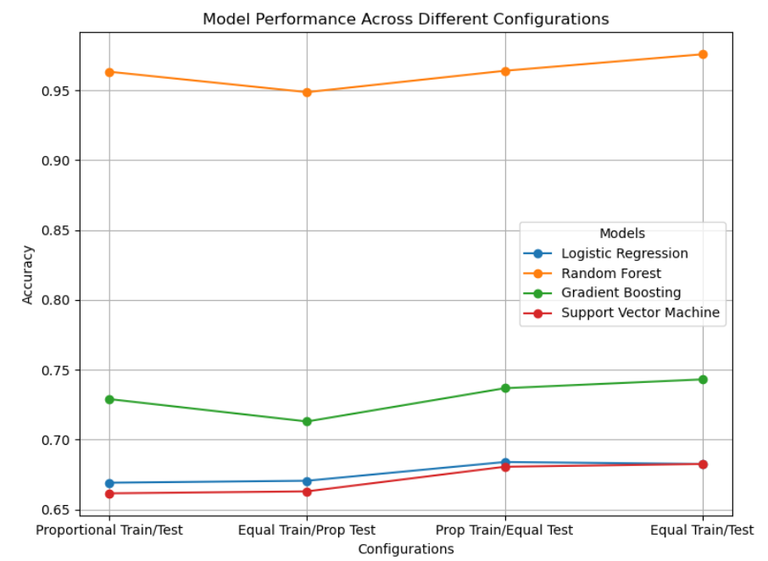

Slide 15
Comparison of Results with Other Models
Improvement Over Reference Paper:
Our optimized models achieved higher accuracy than those in Reference Paper, particularly under the equal/equal configuration.
Random Forest: Achieved the best overall performance, surpassing Reference Paper’s Extreme Gradient Boosting (84.95%) with accuracies above 85% in multiple configurations.
Configurations Comparison:
Equal Training and Testing showed the most consistent improvements across all models, whereas Proportional Training and Equal Testing was effective for simpler models like Logistic Regression.
Metrics Comparison:
Precision and Recall: Each optimized model demonstrated improved precision and recall values compared to Reference Paper, highlighting the ability to detect CHD cases with fewer false positives and negatives.

Slide 16
Comparison Table
Model | Proportional Train/Test |  | Equal Train/Prop Test |  | Prop Train/ Equal Test |  | Equal Train/Test
 | Previous Accuracy | Our Accuracy | Previous Accuracy | Our Accuracy | Previous Accuracy | Our Accuracy | Previous Accuracy | Our Accuracy
Random Forest | 60.91% | 96.32% | 62.11% | 94.86% | 62.87% | 96.39% | 63.59% | 97.57%
Support Vector | 84.95% | 66.16% | 57.95% | 66.30% | 50.00% | 68.06% | 66.41% | 67.85%
Gradient Boosting | 84.95% | 72.90% | 61.94% | 71.30% | 50.83% | 73.68% | 64.86% | 74.31%
Logistic Regression | 81.80% | 66.92% | 82.68% | 67.06% | 81.85% | 68.40% | 82.18% | 68.26%

Slide 17
Conclusion
Summary of Improvements:
The enhanced preprocessing techniques, balanced configurations, feature selection, and hyperparameter tuning led to significant improvements over the baseline models.
Our Random Forest Model, combining multiple algorithms, provided the best accuracy and reliability for predicting cardiovascular disease risk.
Benefits of Our Approach:
Improved predictive accuracy ensures earlier identification of high-risk patients.
Increased model interpretability and consistency across configurations make this approach viable for real-world healthcare applications.
Future Directions:
Explore additional ensemble methods and deep learning techniques, such as neural networks, to further boost accuracy.
Integrate explainable AI techniques for greater clinical interpretability, providing healthcare professionals with insights into the factors driving predictions.

Slide 18
References (If possible include citations)
Framingham heart study dataset (kaggle.com)
[2402.15005] Comparison of Machine Learning Classification Algorithms and Application to the Framingham Heart Study (arxiv.org)
Chen, Y.-S.; Cheng, C.-H.; Chen, S.-F.; Jhuang, J.-Y. Identification of the Framingham Risk Score by an Entropy-Based Rule Model for Cardiovascular Disease. Entropy 2020, 22, 1406. Identification of the Framingham Risk Score by an Entropy-Based Rule Model for Cardiovascular Disease
Evaluation-of-Machine-Learning-Models-for-Predicting-Cardiovascular-Disease-Based-on-Framingham-Heart-Study-Data.pdf (researchgate.net)
Mariettou, S., Koutsojannis, C., Triantafillou, V. (2024). Predicting Coronary Heart Disease Through Machine Learning Algorithms. In: Daimi, K., Al Sadoon, A. (eds) Proceedings of the Third International Conference on Innovations in Computing Research (ICR’24). ICR 2024. Lecture Notes in Networks and Systems, vol 1058. Springer, Cham. Predicting Coronary Heart Disease Through Machine Learning Algorithms | SpringerLink
Guarneros-Nolasco, L.R.; Cruz-Ramos, N.A.; Alor-Hernández, G.; Rodríguez-Mazahua, L.; Sánchez-Cervantes, J.L. Identifying the Main Risk Factors for Cardiovascular Diseases Prediction Using Machine Learning Algorithms. Mathematics 2021, 9, 2537. Identifying the Main Risk Factors for Cardiovascular Diseases Prediction Using Machine Learning Algorithms
Kahouadji, N. On the Generalizability of Machine Learning Classification Algorithms and Their Application to the Framingham Heart Study. Information 2024, 15, 252. On the Generalizability of Machine Learning Classification Algorithms and Their Application to the Framingham Heart Study
Ding, Huitong et al. ‘Multimodal Machine Learning for 10-Year Dementia Risk Prediction: The Framingham Heart Study’. 1 Jan. 2023 : 277 – 286. Multimodal Machine Learning for 10-Year Dementia Risk Prediction: The Framingham Heart Study - IOS Press
You J, Guo Y, Kang J- J, et al. Development of machine learning- based models to predict 10- year risk of cardiovascular disease: a prospective cohort study. Stroke & Vascular Neurology 2023;8: e002332. doi:10.1136/svn 2023-002332 Development of machine learning-based models to predict 10-year risk of cardiovascular disease: a prospective cohort study (bmj.com)

